Slide 1
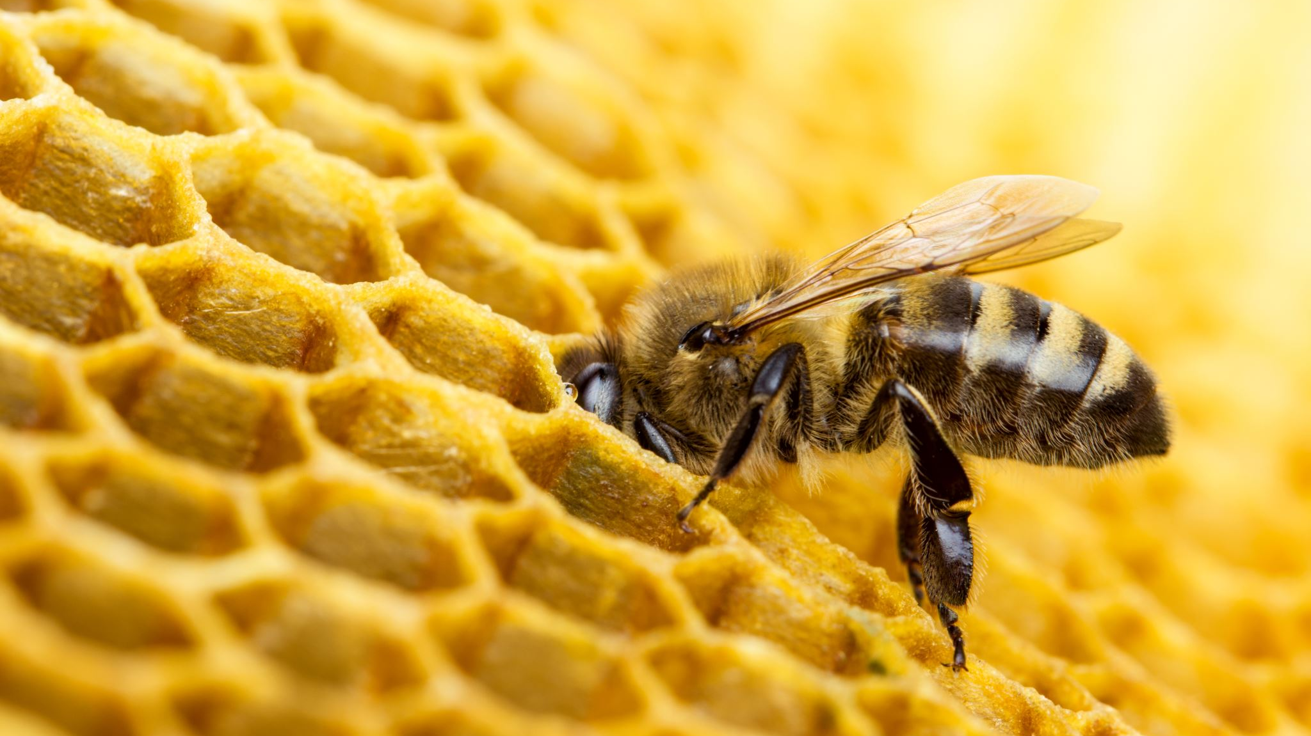
BEES: Fantasy Golf
We need a better title for this

Slide 2
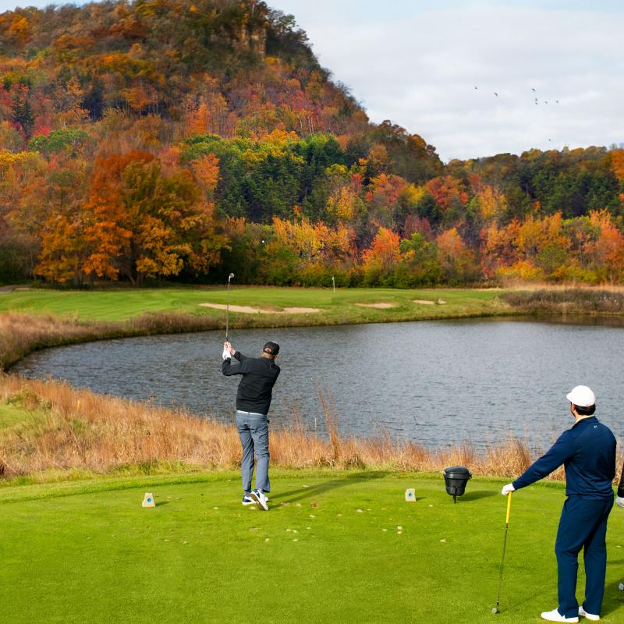
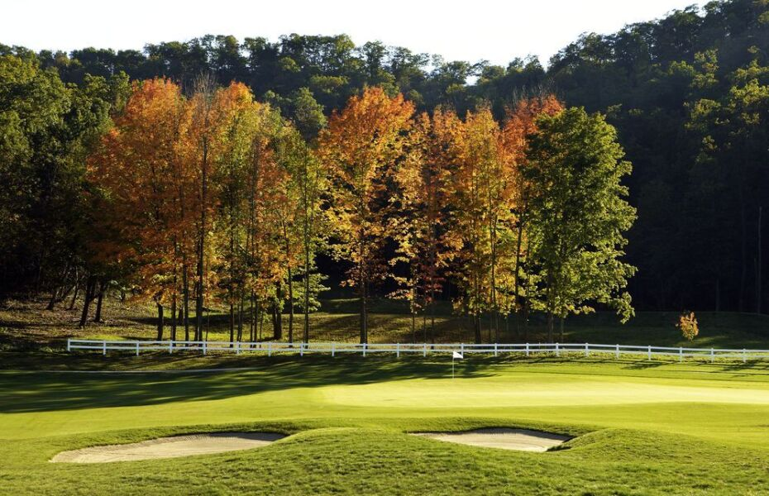

The Jewel, MN

Slide 3




The Old Works,
Anaconda MT

Slide 4

Overview
Fantasy Golf? What? Why? How?
The 2022 Masters tournament: do we suck at this?
Avoiding having to create models, thanks DraftKings
It works (maybe?), but is it really worth it?
Future thoughts: How do we estimate the number of times a golfer is chosen?

Slide 5
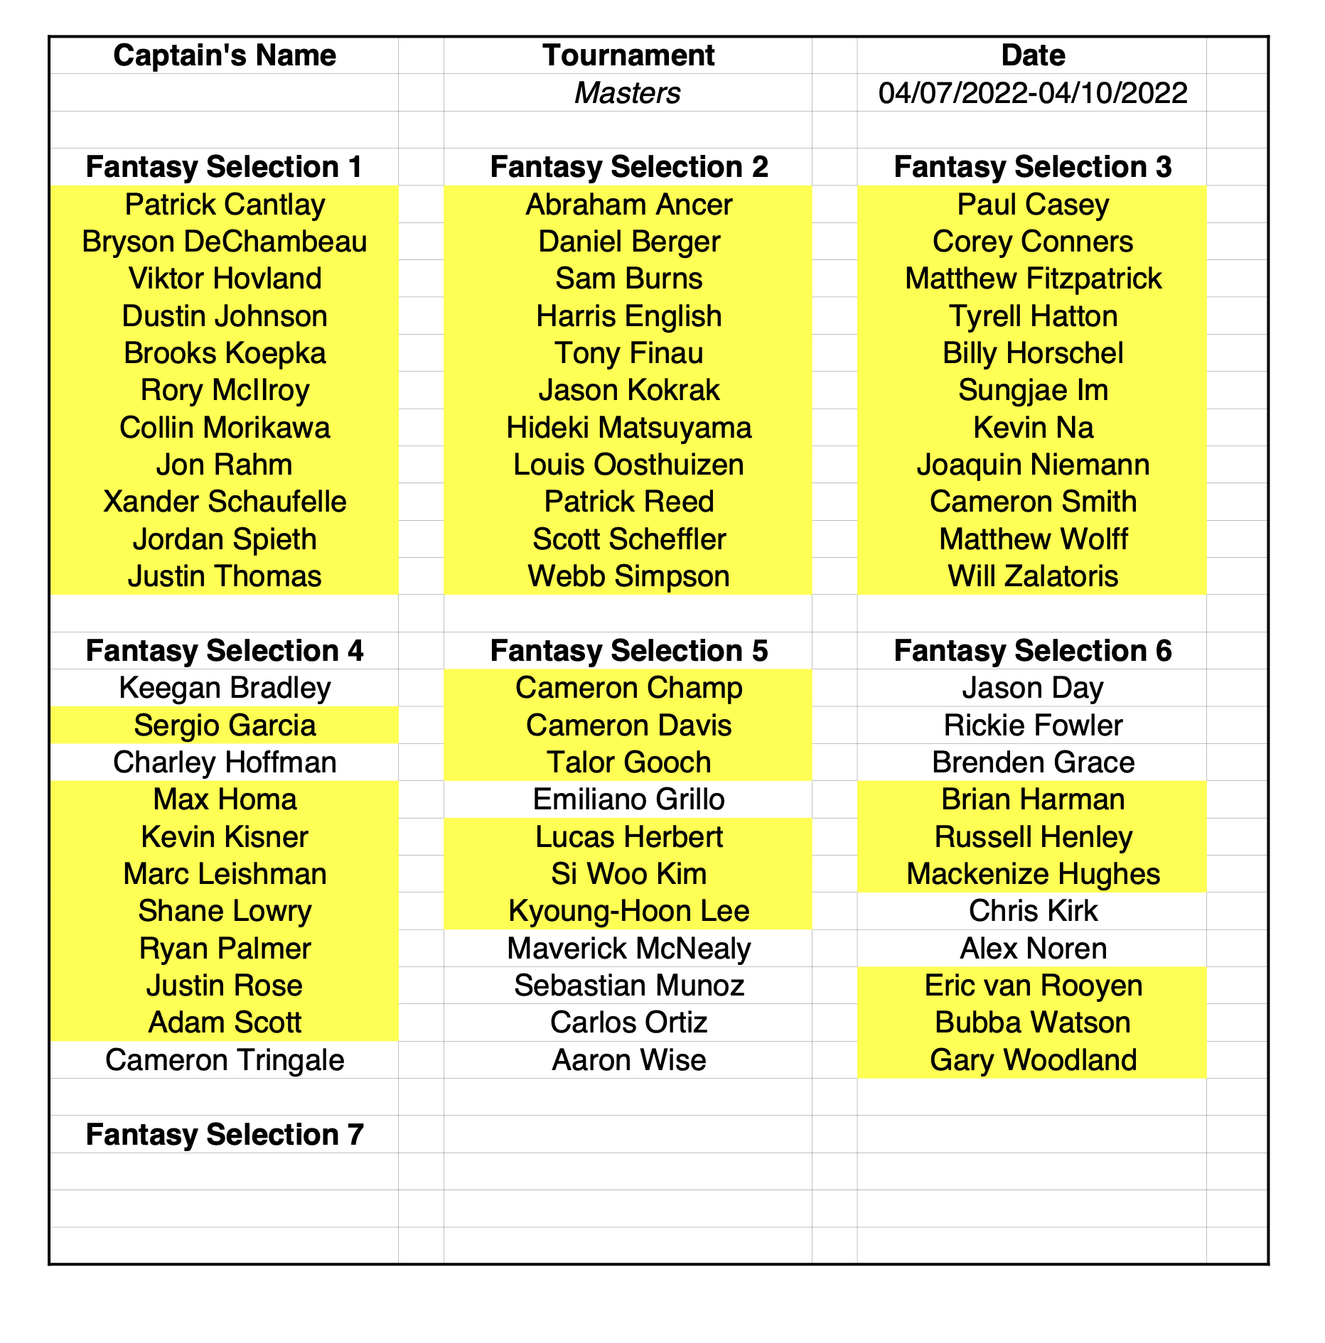
What is fantasy golf?
Choose one player from each group and one WC from any group or no group at all for your “team” each week
Highlighted = Playing this week
If there are less than 3 players in a group, you can choose any player as extra WC
Groups set at beginning of year and never changed
Groups chosen by the commissioner by a brain algorithm based on OWGR, 2021 money list, and group balance & theme

Slide 6
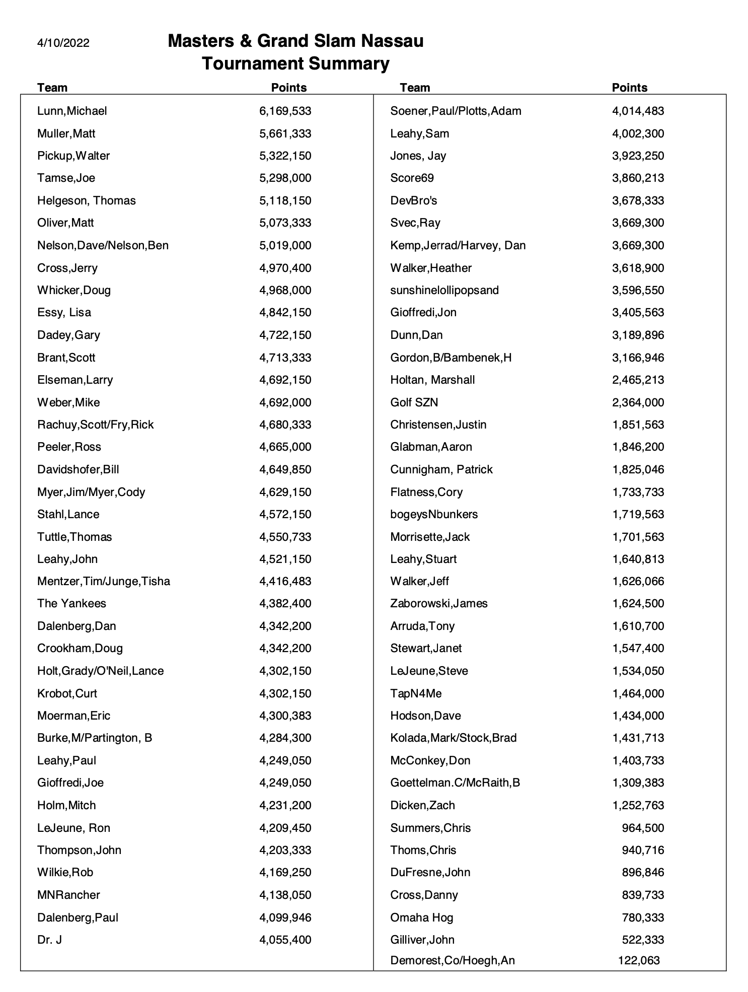
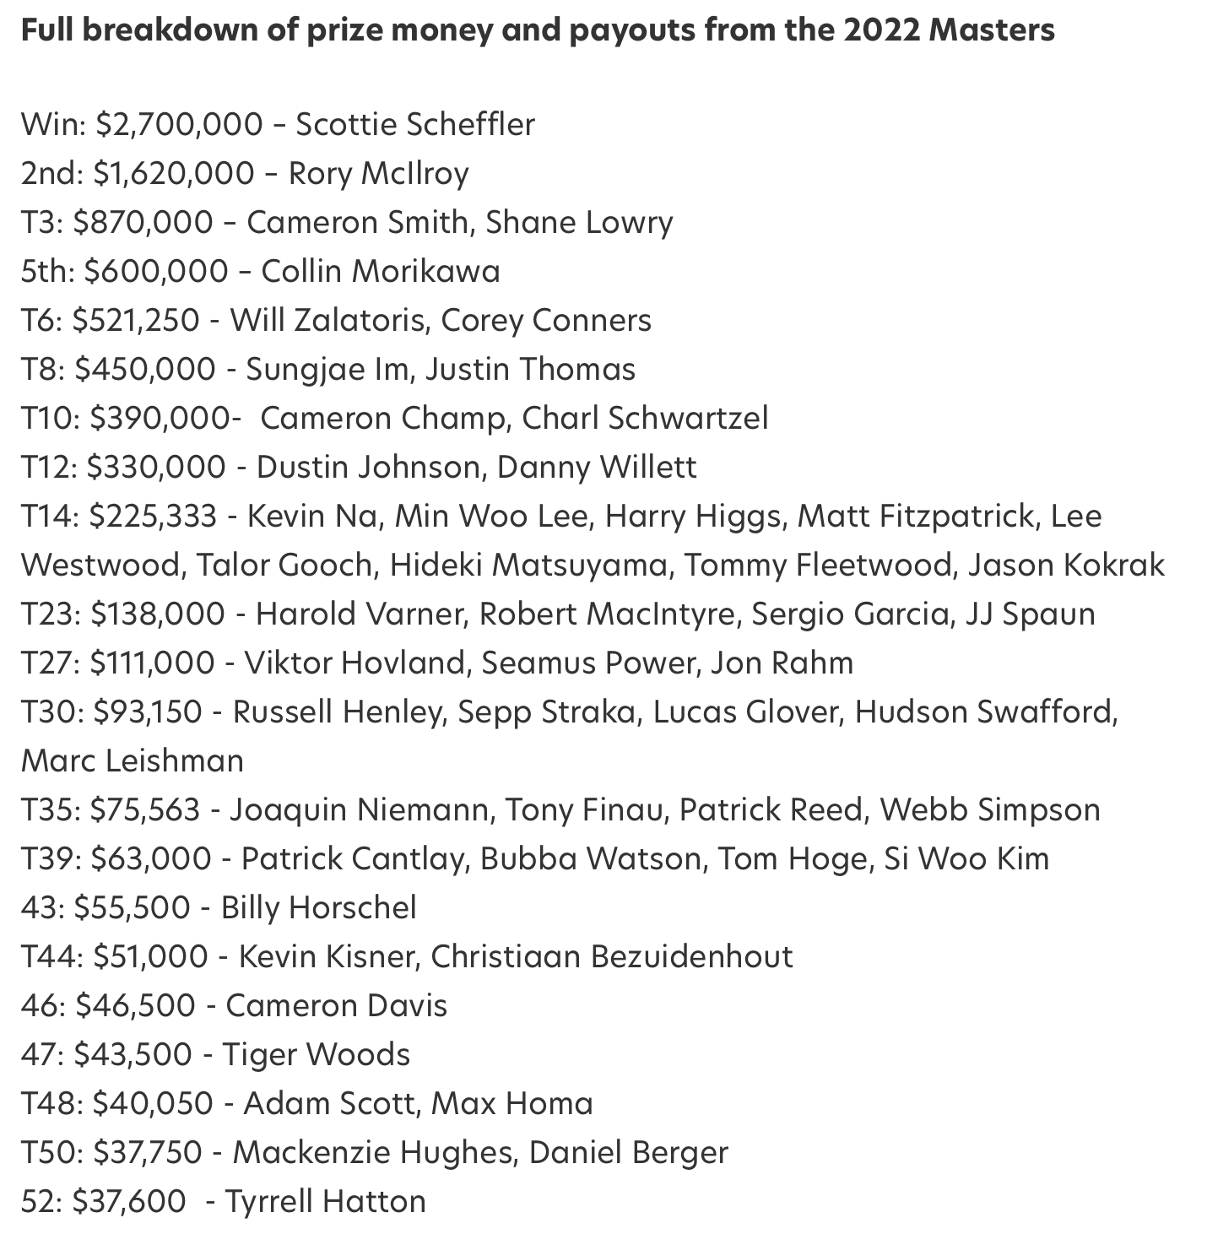
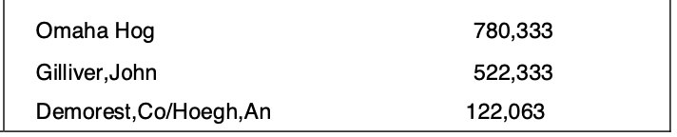
Fantasy Scoring
…

Slide 7
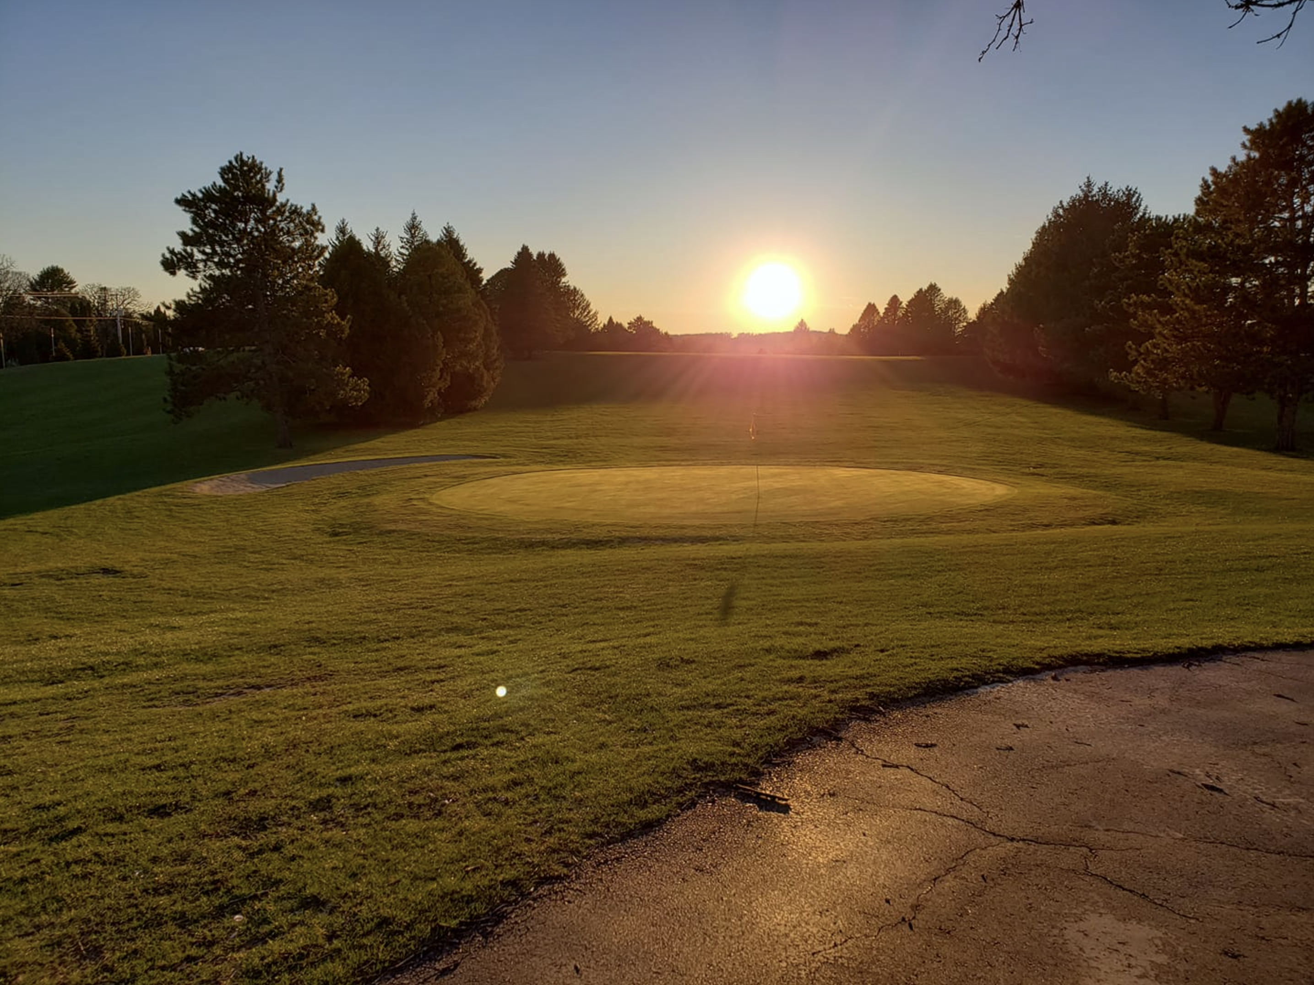
So why is this hard? Just pick the best players?
Shiny app: Why picking the best player may not be best

Slide 8

Overview
Fantasy Golf? What? Why? How?
The 2022 Masters tournament: do we suck at this?
Avoiding having to create models, thanks DraftKings
It works (maybe?), but is it really worth it?
Future thoughts: How do we estimate the number of times a golfer is chosen?

Slide 9
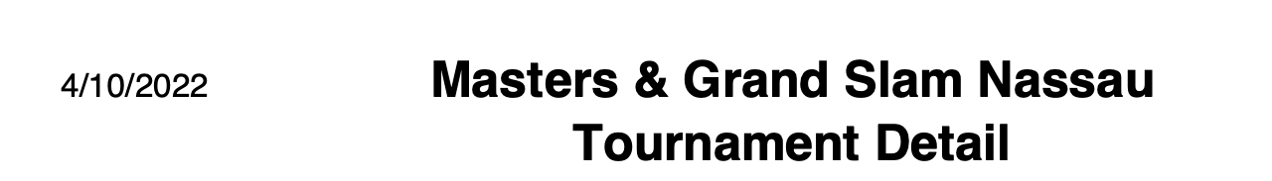
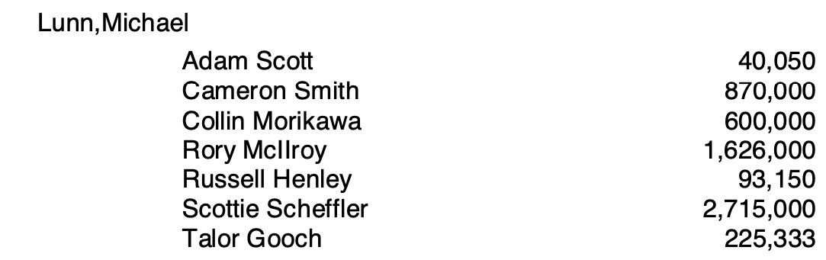
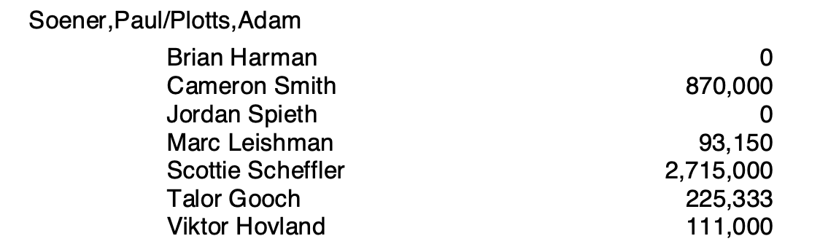
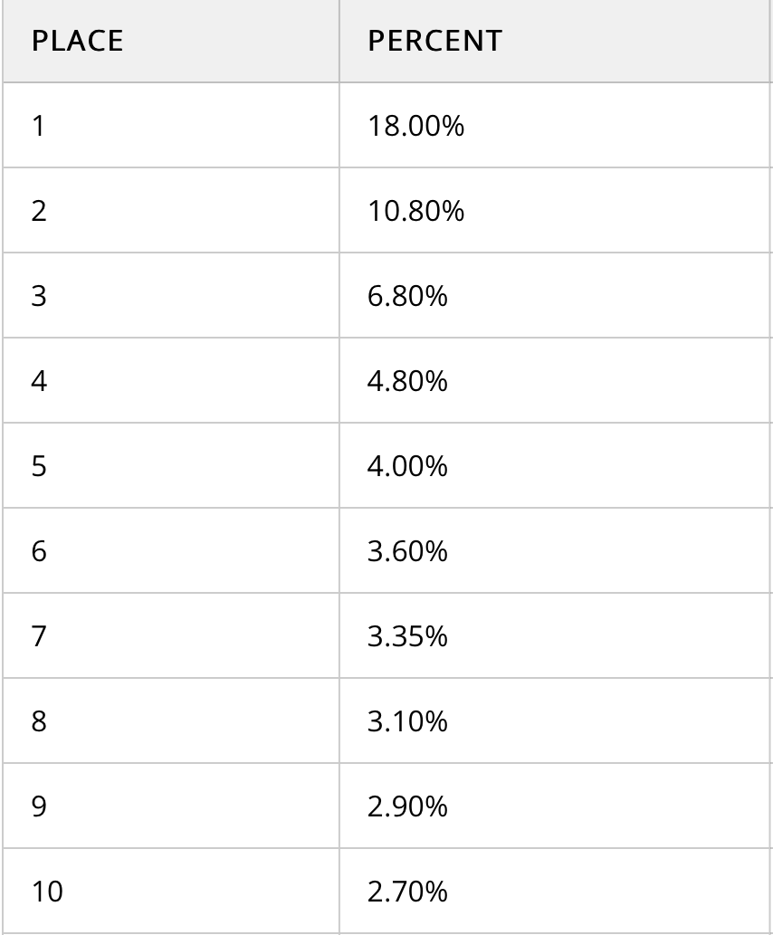
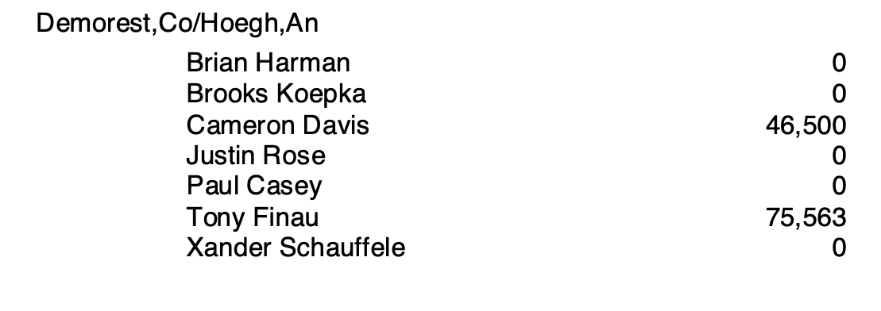
The 2022 Masters fantasy golf week was hard to win…
Result: 1st, +$70
Result: 34th, +$0
Total: 6,169,533
Total purse: 15MM
Result: 77th, +$0
Total: 4,014,483
?
Total: 122,063

Slide 10
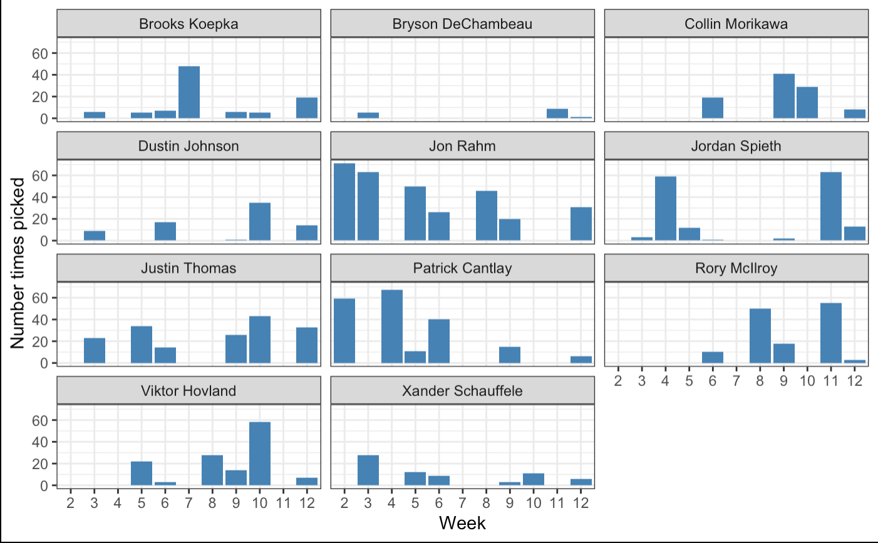
Group 1 golfers, number of times picked Rahm gets picked frequently

Slide 11

Group 1 golfers, proportion of times picked
Theory: if there are more golfers playing in a week, they all get picked less often

Slide 12


Overview
Fantasy Golf? What? Why? How?
The 2022 Masters tournament: do we suck at this?
Avoiding having to create models, thanks DraftKings
It works (maybe?), but is it really worth it?
Future thoughts: How do we estimate the number of times a golfer is chosen?

Slide 13
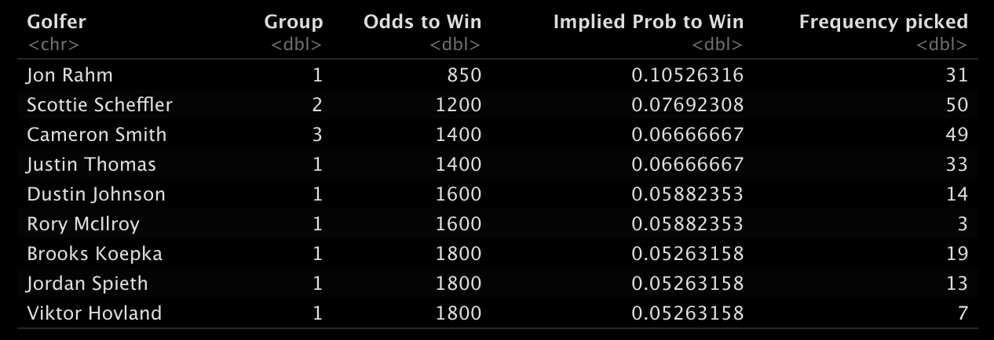
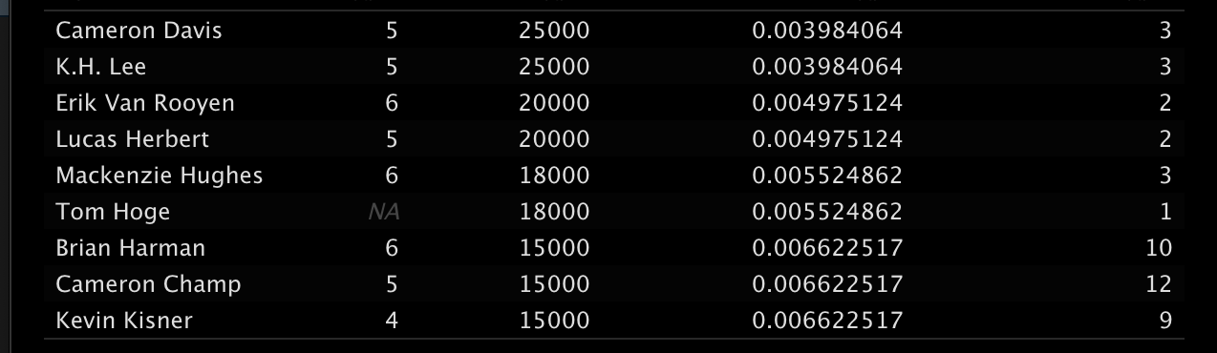
DraftKings odds
Highest Probability to win
DraftKings makes odds for players to win tournaments (as well as top 5, 10, 20, 40, etc)
Their website had the fewest issues with table scraping in R (rvest)
We are not going to consistently outperform DK at predicting winners of tournaments (or we would just do that instead and print money)
Lowest Probability to win among those picked

Slide 14
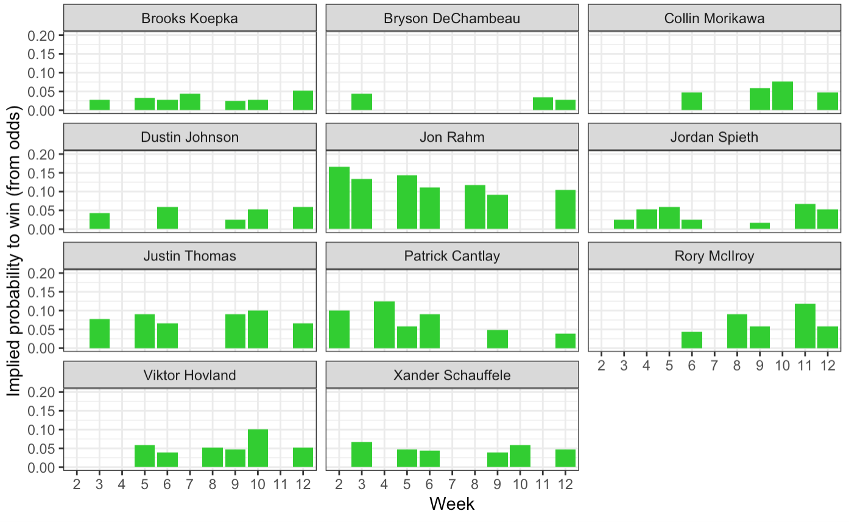
Group 1 golfers, implied probability to win (Note y axis)

Slide 15
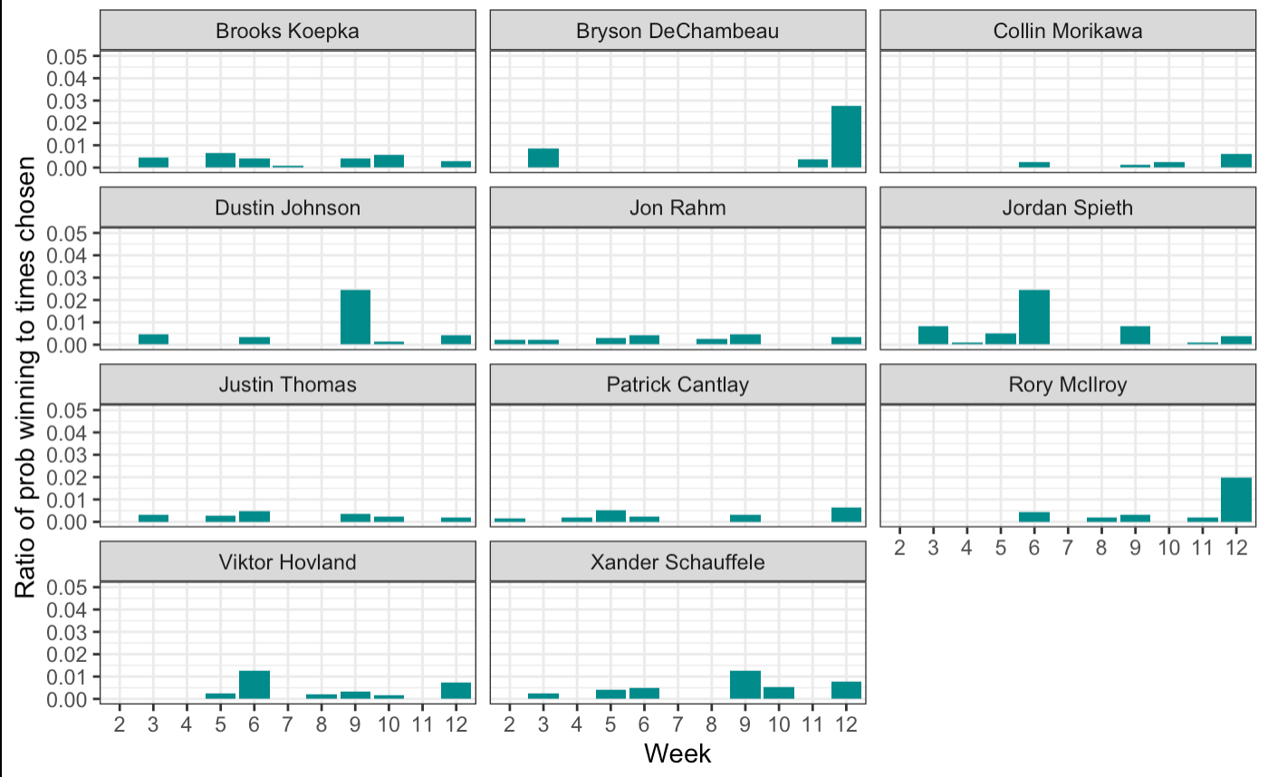
Group 1 golfers: ratio of prop winning and number of times chosen Theory: Maximizing this will give us best chances to win money

Slide 16
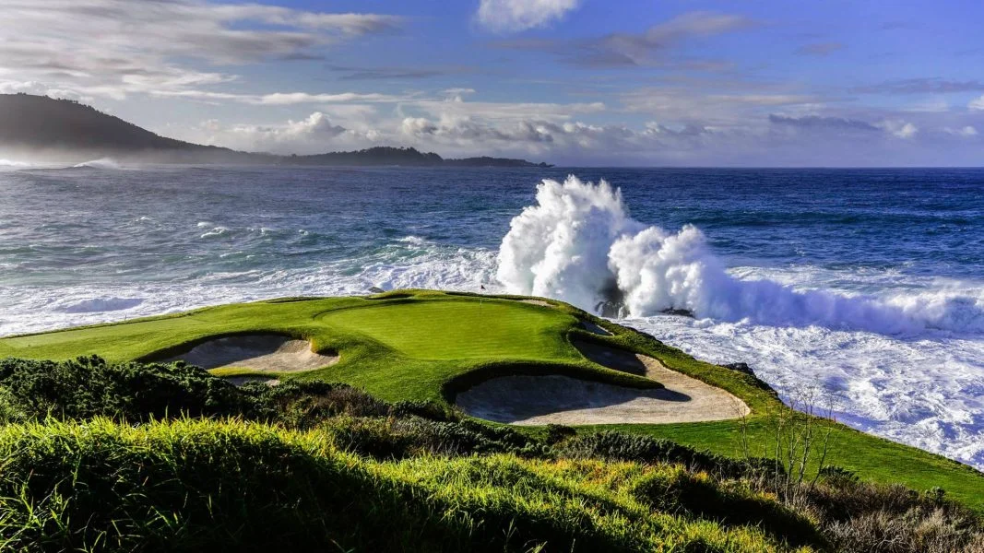
Overview
Fantasy Golf? What? Why? How?
The 2022 Masters tournament: do we suck at this?
Avoiding having to create models, thanks DraftKings
It works (maybe?), but is it really worth it?
Future thoughts: How do we estimate the number of times a golfer is chosen?

Slide 17
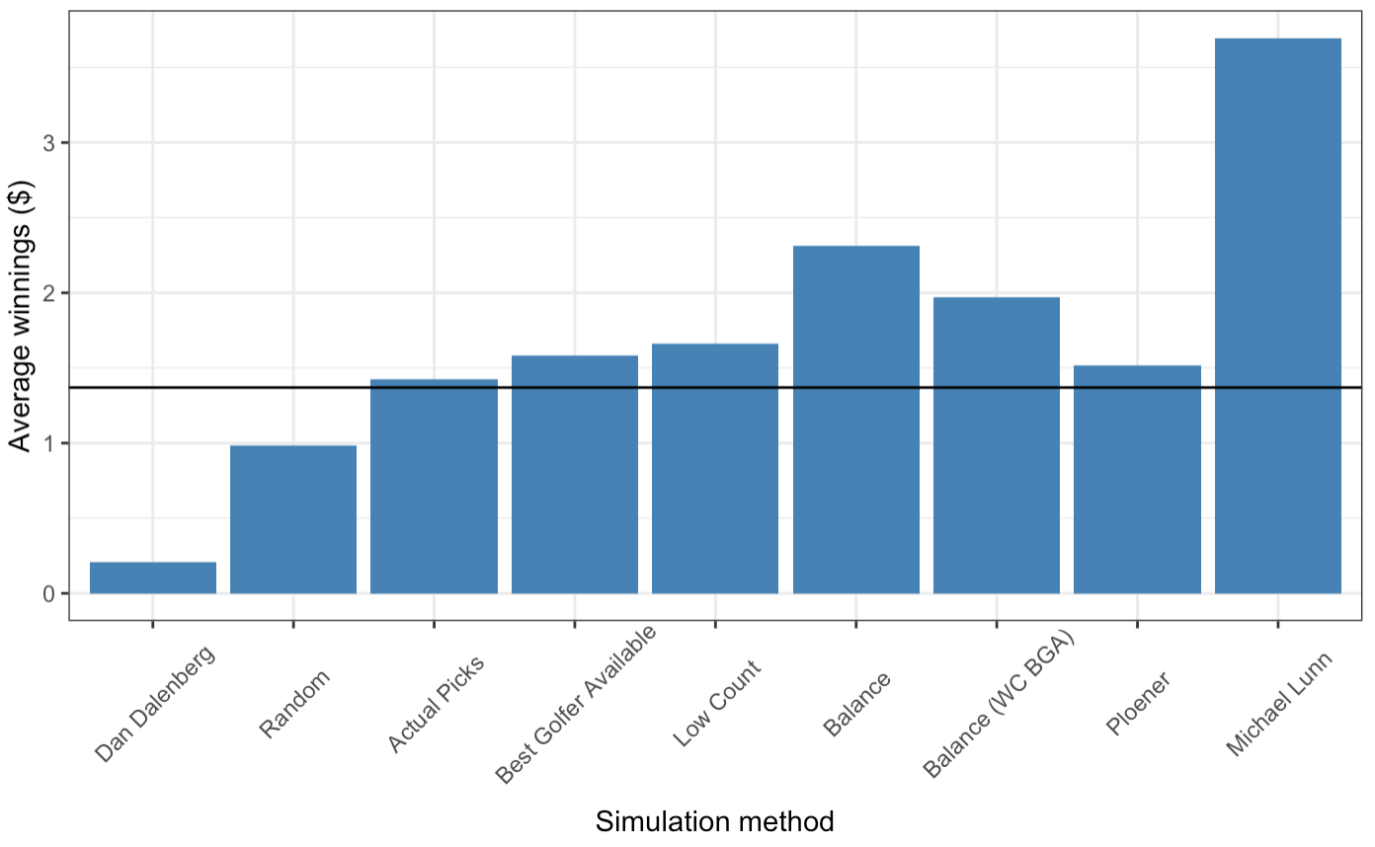
Simulation study: Of the strategies tested, ”Balance” is best average return
5,000 simulations of new tournaments by resampling the order of golfers without replacement
Black line: naive amount of return if everyone has the same chance to win money.
”Balance” method using the highest ratio of probability to win vs number of times picked.
“Dan” and “Michael” are comparisons for the highest and lowest average return. Not sure how you could be this good (or bad) at picking golfers.

Slide 18
Things to consider
Assume: Odds given by DK are proportional to true odds of winning
Assume: Frequencies of how often golfers will be chosen are known before picks are submitted
Our best strategy by simulation makes ~$0.54 more than Team Ploener
About 15$ over the course of a year even assuming everything was done right, and that we can get data that don’t exist…
Our strategy is kind of boring

Slide 19

Overview
Fantasy Golf? What? Why? How?
The 2022 Masters tournament: do we suck at this?
Avoiding having to create models, thanks DraftKings
It works (maybe?), but is it really worth it?
Future thoughts: How do we estimate the number of times a golfer is chosen?

Slide 20
Just curious. How could we predict the number of times a golfer will be chosen?
Golfers don’t play every tournament
Different numbers of golfers play in every group in every week
Sometimes Group 1 golfers are chosen a total of 200 times between all players (due to WC, etc) and sometimes it’s like, 50.

